Slide 1
Status Review
10.01.2018

Slide 2
Last weeks:
Flushed each circuit with flushing device from Welkenrath (R407c)
Further work on the evaporator model
Changed the calculation method of the python script
Started writing

Slide 3
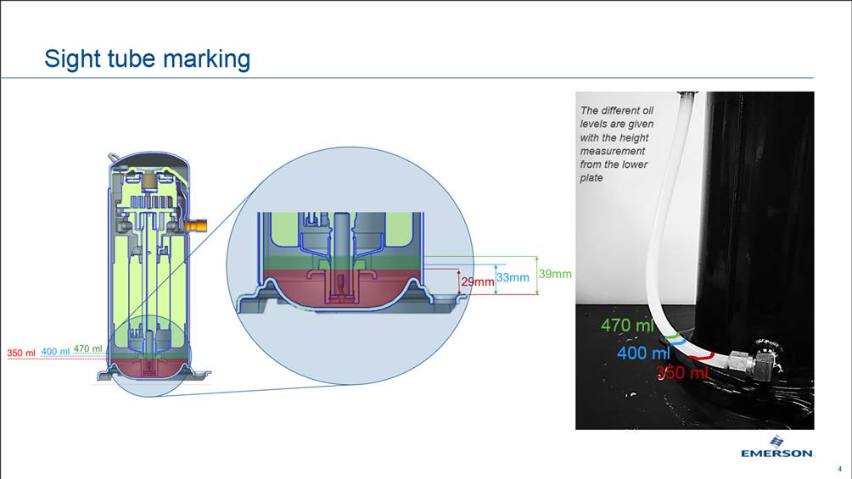
Flushing of the cabinet
No oil in the circuits
Previous filling was
too high
(estimated 600ml
instead of 470ml)

Slide 4

Evaporator model
Previous used equations are only valid for one-phase flow
Pressure drop equations changed → valid for 2-phase flow
ε-NTU method changed to fin correlations → α_{air}
Assumptions:
X_{in} =0
X_{out} =1
Inlet-Conditions: T_{air}, p_{atm},u_{air},T_{refr},p_{refr}
Δh known – equidistant cells
Flow boiling
Dry air
=> Goal is to see a trend of the evaporator performance

Slide 5
Python script

Slide 6
To-Do:
Test-Plan according to DoE
Schedule Testing order
Testing
Representative Evaporator arrangements
Parameters?
Evaporator | Condensor | T_{COND} | T_{DEFROST}
Current arrangement | SWEP_{CURRENT} | 55 | 4
LIDL-Design | SWEP_{SMALL} | 45 | 3
V₁ |  | 55 | 2
V₂ |  |  | manual

